Slide 1
Gnod - Song Recommendation Engine MVP
Alex Chen

Slide 2
Business case and strategic benefits
Built on the existing prototype - artist recommendation
Customer profile | Customer need
Young, trendy, social media user | Customer has a top or popular song (from Billboard 100) at the moment and would like to hear more top songs?
Slightly older, likes classic songs, but keen to experience trendy popular music | Customer has a non top song in mind that you like and want to know another top song that’s similar?

Slide 3
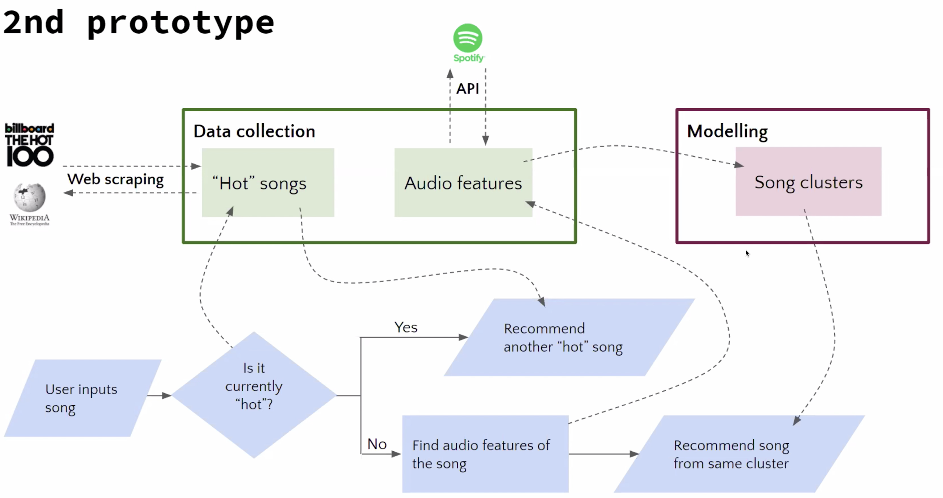
Song recommendation engine - specification

Slide 4
Audio Features for grouping
"Danceability"
"Energy"
"Key"
"Loudness"
'Mode'
'Speechiness'
'Acousticness',
'instrumentalness'
'Liveness'
'Valence'
'tempo'

Slide 5
Demo

Slide 6
Approach and walkthrough
Hot / top used interchangeably
Obtained the current 100 top songs from Billboard, through web-scrapping. This is to be updated every week to match BIllboard.
For the top songs, added features to the data frame which were obtained from Spotify API. Only numerical features were added. Exported as csv file. This is also to be done weekly as songs will be updated weekly.
Loaded csv file and transformed features with standard scaler for same scalling. Checked best k value and Silouhette score for k means clustering, and assigned songs to clusters with kmeans.predict().
Predict user input song (if not hot song): got features, transformed, and used the same kmeans to predict the cluster. Returned user a hot song from same cluster from top 100 songs.
If user entered hot song, recommends another hot song from Billboards 100.

Slide 7
Future developments
Increase dataset to include all songs in spotify for non top song input, and recommend a similar song ( top or non top song ).
Use Kaggle dataset for spotify
Create user preferences profile database and adapt song recommendation to take into consideration user preferences

